Slide 1

The Machine Learning Process
Q & A
Dr. Reza Dibaj

Slide 2
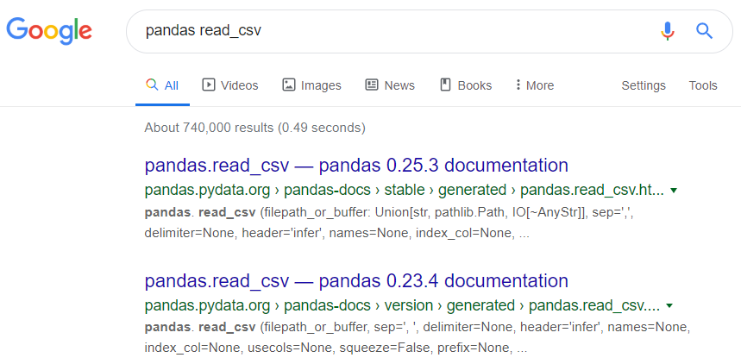
Question 1
Q: Please explain how to read the pandas docs.
R: The easiest way is to google it!

Slide 3
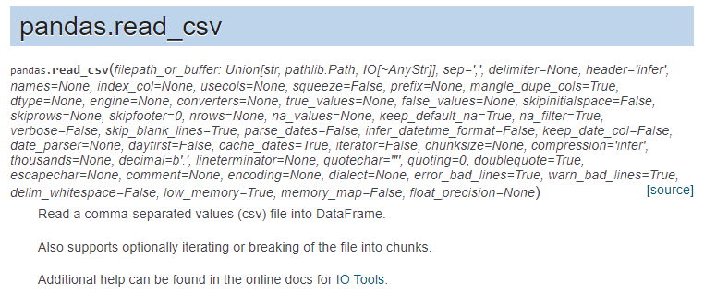
Question 1
R: It shows it is a top-level function that we need to call it by typing pd.read_csv, if we have imported pandas as pd.
The rest are mandatory and optional parameters.

Slide 4
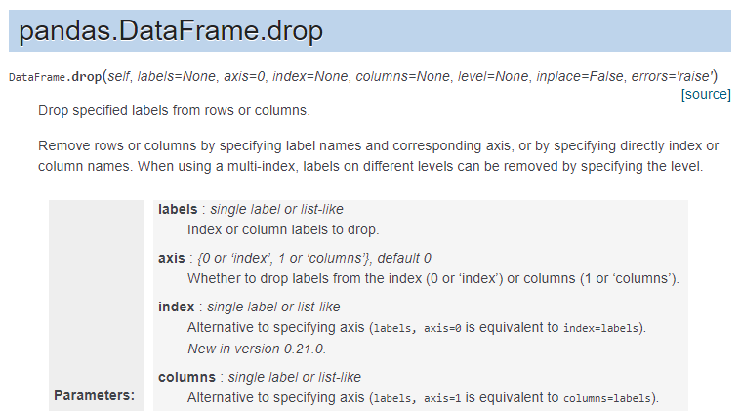
Question 1
R: Another example…. A DF method, that we need to use DF.drop and not pd.drop.

Slide 5
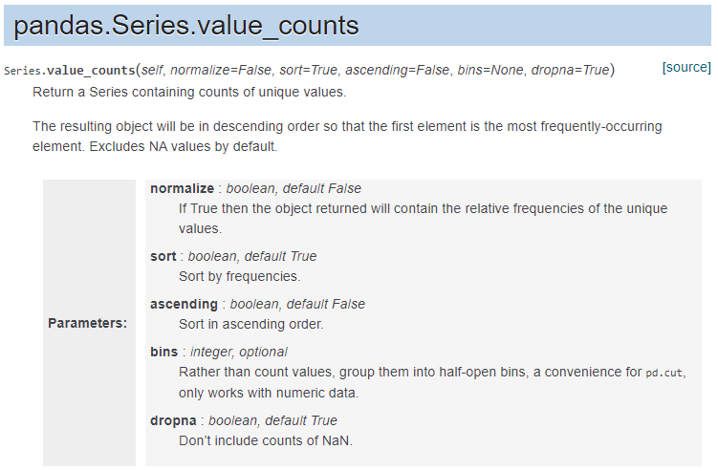
Question 1
R: Another example…. A Series method, that we need to use Series.value_count.

Slide 6
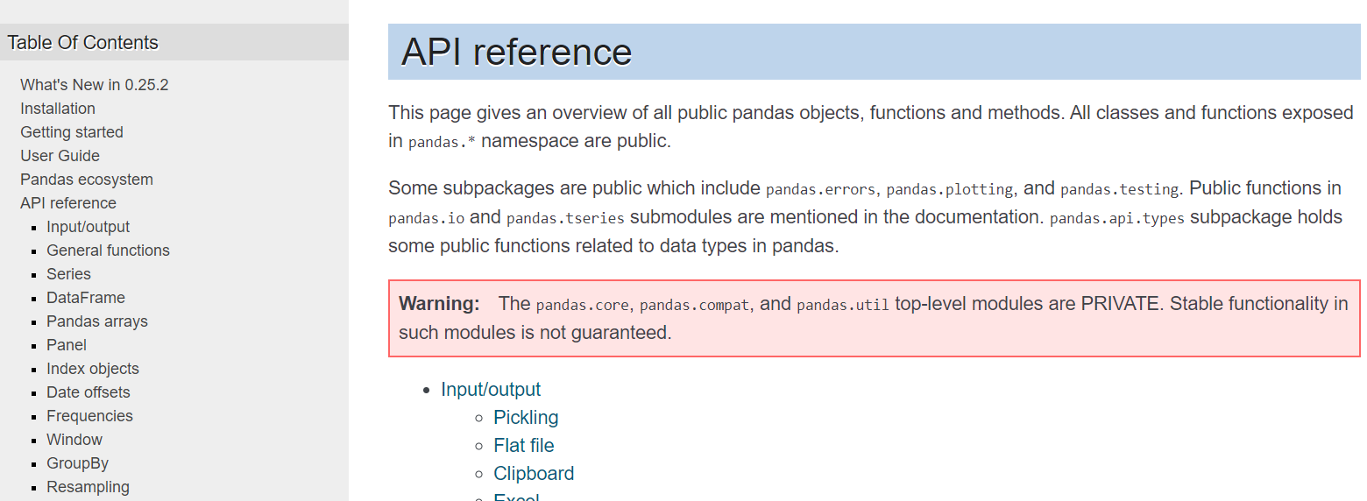
Question 1
R: pandas API reference document is another useful documentation that are available for pandas.

Slide 7
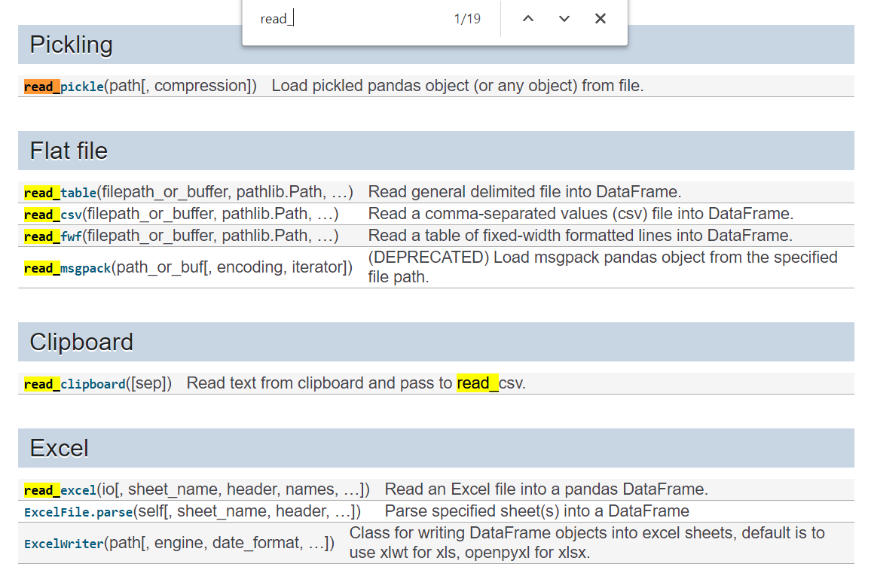
Question 1
R: For instance, if I want to see apart from read_csv what other read_ methods could I use, I need to click on Input/Output and search by pressing Ctrl + F.

Slide 8
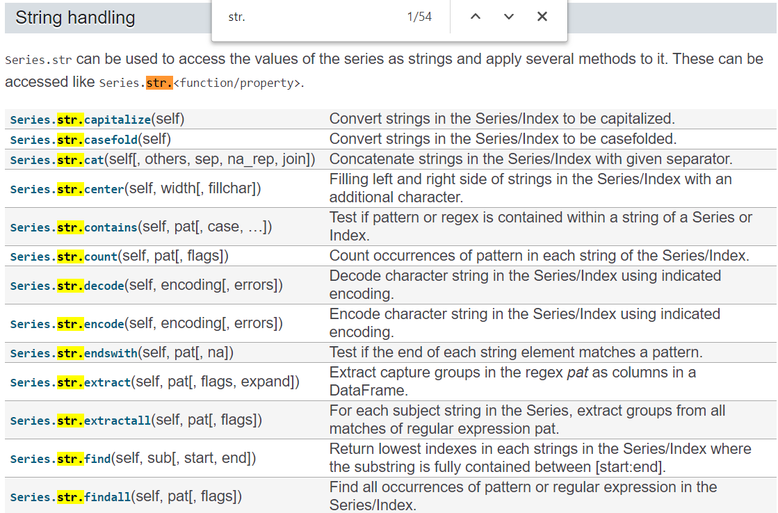
Question 1
R: Another example for string method… We need to go to Series and search for “str.”

Slide 9
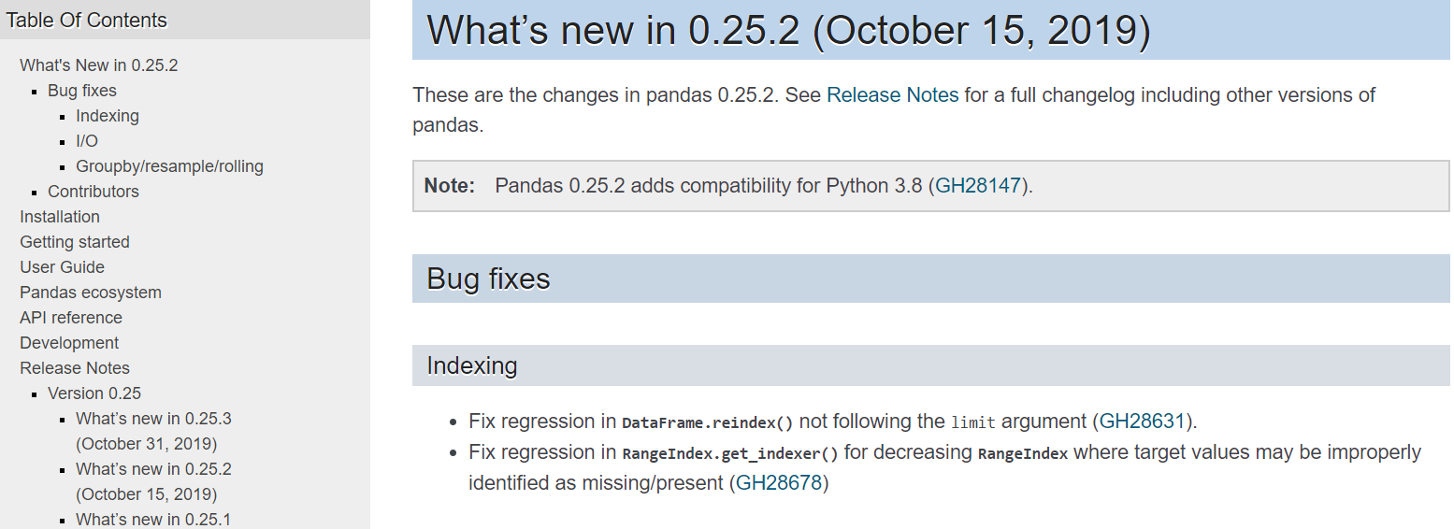
Question 1
R: In What’s New we can access to what has added to the new version or what is modified.

Slide 10
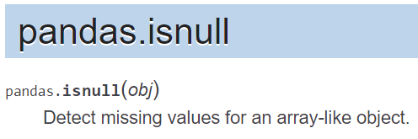
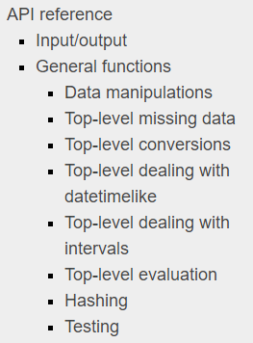
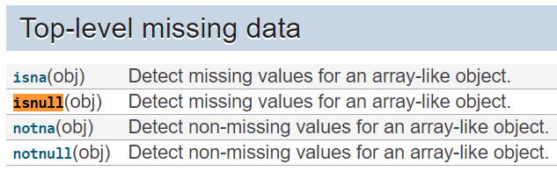
Question 2
Q: The result of DF.isnull() is similar to pd.isnull(DF). Is there any essential difference between them?
R: Let’s google pandas isnull()… There are three types of missing value search methods in the document. The first one is called Top-level missing data:

Slide 11
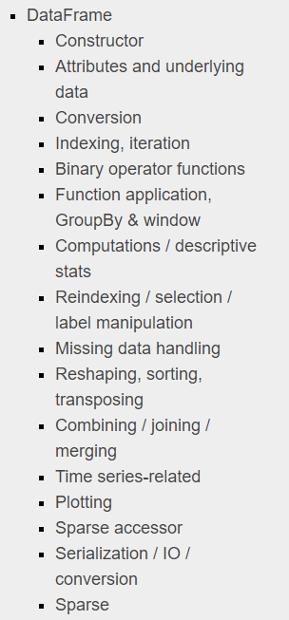
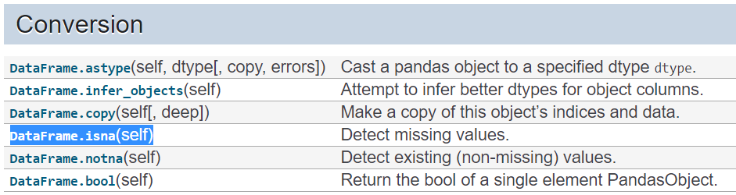
Question 2
R: The second type is a DF method which is represented as DF.isna():

Slide 12
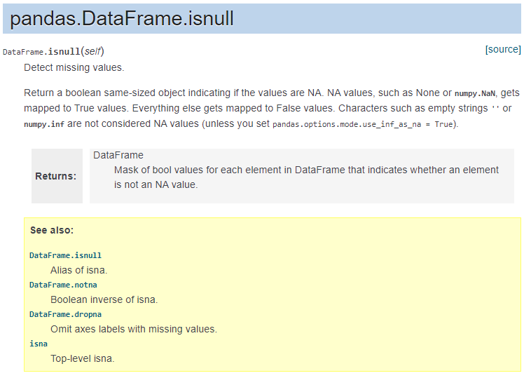
Question 2
R: You can also use DF.isnull() as the alias of isna():

Slide 13
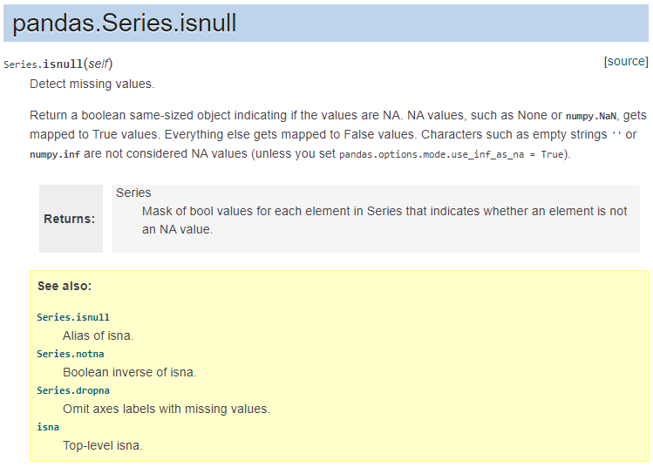
Question 2
R: And the last one is in the Series level, we also have Seies.isna() as the main method and the Series.isnull as the alias:

Slide 14
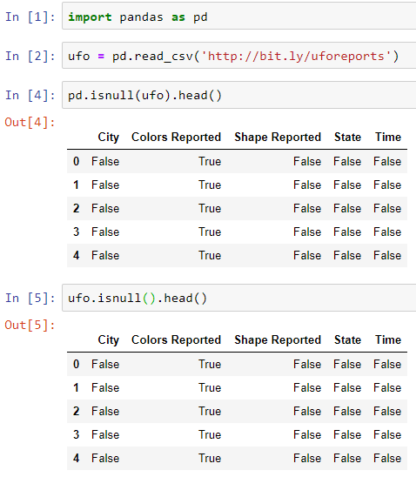
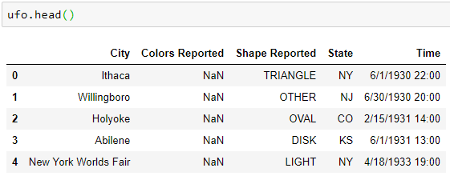
Question 2
R: Let’s see an example:
Notes:
import pandas as pd
ufo = pd.read_csv('http://bit.ly/uforeports’)
pd.isnull(ufo).head()
ufo.isnull().head()
ufo.head()

Slide 15
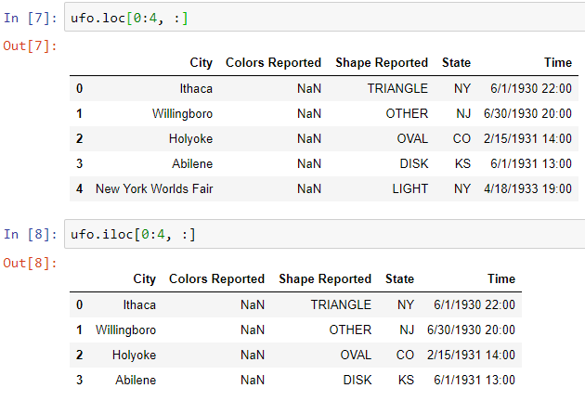
Question 3
Q: It seems that the pandas team is split between inclusive ranges and exclusive ranges. E.g. 0:4 is different from loc() to iloc(). Do you know why?
R: Let’s look at the following example:
Notes:
ufo.loc[0:4, :]
ufo.iloc[0:4, :]

Slide 16
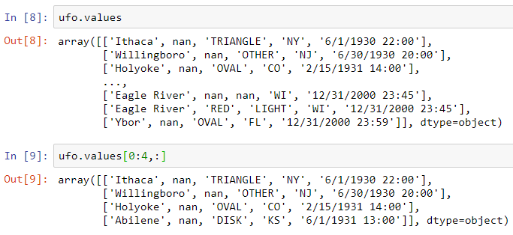

Question 3
R: pandas is built on NumPy and whenever it can, it follows NumPy conventions.
Notes:
ufo.values
ufo.values[0:4,:]
list(range(0,4))

Slide 17
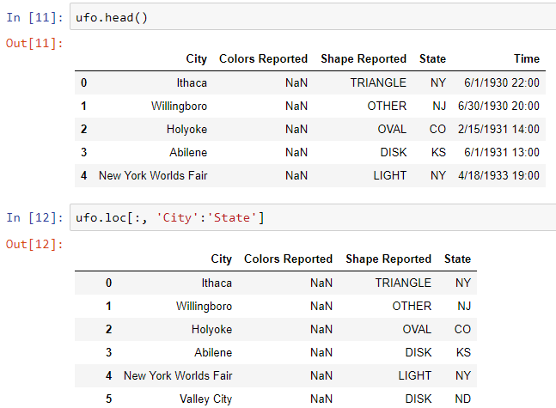
Question 3
R: But why loc() is inclusive on both sides?
Notes:
ufo.head()
ufo.loc[:, 'City':'State']

Slide 18
Question 3
R: In short, both loc() and iloc() make totally sense separately, and now you can explain why.

Slide 19
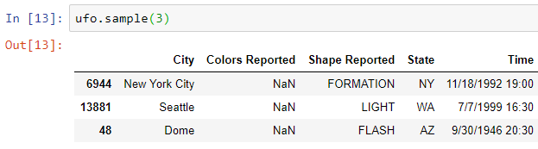
Question 4
Q: How can we handle large csv files in pandas? Is thee a practical way to randomly sample rows?
R: Let’s take a look at random sampling in pandas, using a DF method, called sample(). E.g. DF.sample(3) and I get 3 random sample rows:
Every time you run this code you get different results.
Notes:
ufo.sample(3)

Slide 20

Group Discussion
What is reproducibility? How can we apply reproducibility on sample() method?

Slide 21
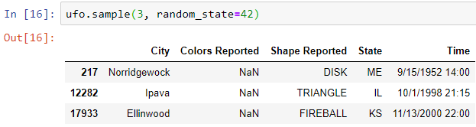
Question 4
R: Here is how we apply reproducibility….
Notes:
ufo.sample(3, random_state=42)

Slide 22
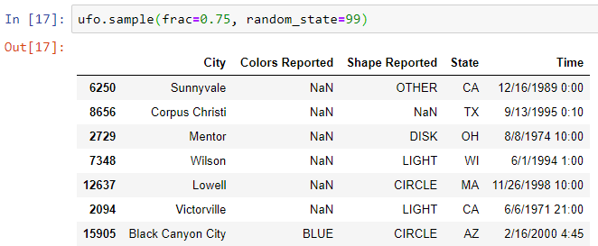
Question 4
Q: What if we want to select a fraction of rows?
R: Here is how we select a fraction of the rows, e.g. 75% of the rows:
Notes:
ufo.sample(frac=0.75, random_state=99)

Slide 23
Group Discussion
In the concept of ML, how can we split the DF into training and testing set, without overlapping?

Slide 24


Bonus Tip
In the concept of ML, how can we split the DF into training and testing set, without overlapping?
Notes:
train = ufo.sample(frac=0.75, random_state=99)
test = ufo.loc[~ufo.index.isin(train.index), :]

Slide 25
Bonus Tip
And here is another method….
https://towardsdatascience.com/train-test-split-and-cross-validation-in-python-80b61beca4b6

Slide 26

Thank you
Question?
To be
Not to be

